Slide 1
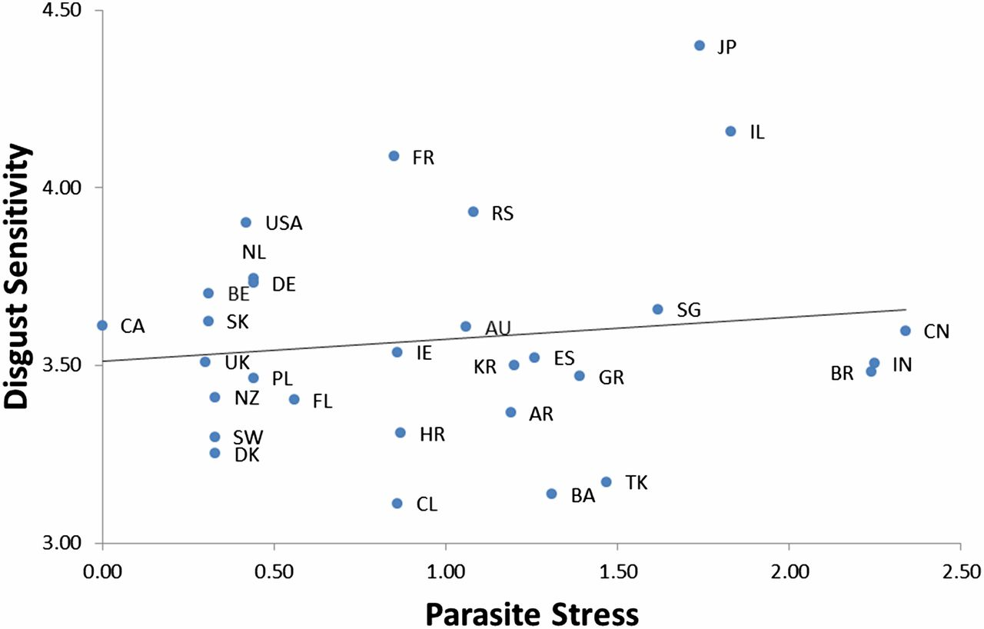
The scatterplot displays the relationship between national parasite stress and disgust sensitivity (r = 0.18).
Joshua M. Tybur et al. PNAS 2016;113:12408-12413
©2016 by National Academy of Sciences
Notes:
The scatterplot displays the relationship between national parasite stress and disgust sensitivity (r = 0.18). Each data point [labeled with a two-letter country code (abbreviations defined in Table 1)] represents a nation's mean disgust sensitivity, controlling for sample demographic characteristics (age and sex).

